Slide 1
Final Project Report
BIOENGRM260

Slide 2
Introduction and Method
Introduction
The purpose of this project is to develop a MATLAB script that extract and classify spikes from a segment of EMG signal.
A fully automated algorithm is developed.
Wavelet denoising is used to filter the raw signal.
Non-linear energy operator (NEO) is applied to detect action potential activities.
A naïve feature space (voltage at certain time stamps) is used.
T-SNE is used for dimensionality reduction.
Single-linkage clustering is used with thresholding to eliminate noise and potential over classification.
Analysis include firing rate over time with Gaussian window, distribution of inter-spike interval, and phase locking of 1 EMG recording.

Slide 3
Method
Filter signal
Three steps are applied to filter the raw signal.
1: Baseline removal by subtracting the mean of the raw signal.
2: Perform 6-level wavelet decomposition and set all approximate coefficients to zero. Then, reconstruct the signal using the new coefficients. This step also removes baseline drifting.
3: Perform wavelet denoising with 4 to 5 levels of wavelet decomposition, with minimax method, Daubechies 4 wavelet (as it most resembles the shape of action potential), level dependent and hard thresholding.

Slide 4
Method
Spike Detection
A second-order non-linear Energy Operator is used to capture the sudden change in EMG signal. A large sudden change in the energy may indicate the existence of a spike.
A threshold level at 0.5 to 1 times the RMS value of the NEO spectrum is used to adapt different EMG signal. A peak in NEO spectrum greater than the threshold is identified as an action potential (AP).
For EMG recordings that have relatively more overlapped APs, NEO tends to identify high-level inter-spike changes as APs.
NEO also tends to misidentify the center of an AP when the width of AP is relatively small.

Slide 5
Method
Spike Alignment
The peak identified by NEO is further processed to obtain the center of Aps for spike alignment.
A peak in the NEO spectrum is not necessarily the peak of a spike. Therefore, the algorithm searches a few adjacent points near the peak to identify the location that has the greater amplitude.
Then, around 30 samples (15 on each side) adjacent to each peak is truncated to form aligned spikes.

Slide 6
Method
Feature Extraction
A naïve feature space that contains 13 samples around the peak of AP is used at the beginning. After these features are fed into T-SNE, the 3-dimension outputs from T-SNE is further used for clustering.
Both data normalization and standardization have been tested. However, due to the nature of T-SNE, they lead to worse separability.
Weighted feature space (more weights at the center of APs) have been tested. No significant improvement can be found.
T-SNE is tuned to have a small number of neighbors, which makes the data more separable. However, a small number of neighbors creates the problem of over classification at the same time.

Slide 7
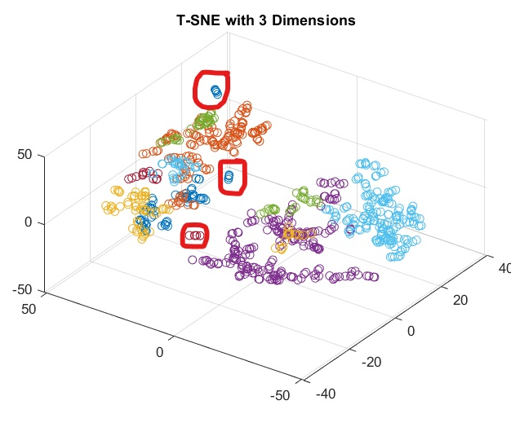
Method
Spike clustering
As shown in the figure, T-SNE tends to drag similar items closer. In this case, hierarchical clustering may be a better choice than k-mean.
Single-linkage is selected over complete linkage, with the intent to isolate small amounts of similar signals that are not action potentials (Shown in the red circle).
Then, a threshold is determined to remove clusters that have small number of samples.

Slide 8
Method
Spike clustering
As shown in the figure, T-SNE tends to drag similar items closer. In this case, hierarchical clustering may be a better choice than k-mean.
Over classification is a problem under this scheme as T-SNE may separate APs that are not different enough.
Using thresholding to remove classes that have small number of members may drop good classifications. Manual examination shows that class with a few samples could be a distinct AP.

Slide 9
Method
Spike clustering
As shown in the figure, T-SNE tends to drag similar items closer. In this case, hierarchical clustering may be a better choice than k-mean.
Despite of the risk of over and under classification, using a large number of clusters at the beginning then removing small clusters enables the full automation.
Doing so also avoids the fact that Silhouette criterion always indicates 2 as the best number of clusters.

Slide 10
Method
Classify spikes
After single-linkage clustering, a threshold is determined to remove small clusters. The remaining clusters are then averaged.
If needed, one can visually inspect the resulted AP waveform and determine whether some spikes are not distinct enough.

Slide 11
Method
Analysis
2 analysis are performed by default, which are the firing rate over time and the distribution of inter-spike interval. Phase-locking analysis is also tried for the channel 1 signal from “EMG_example_2_fs_2k.csv”.
For firing rate analysis, a small Gaussian window is sliding across the entire MUAPT, replacing the original linear binning method to smooth out the plot
Histogram of inter-spike interval distribution is plotted, which resembles Poisson distribution.
Since channel 1 signal from “EMG_example_2_fs_2k.csv” resembles the neural activities in respond to periodic stimulation, it is selected as the candidate for phase-locking analysis. This signal is truncated into 22 equal-length firing segments and the Fourier Transform of these segments are averaged to see whether it is centered at certain frequency. However, the result is inconsequential.

Slide 12
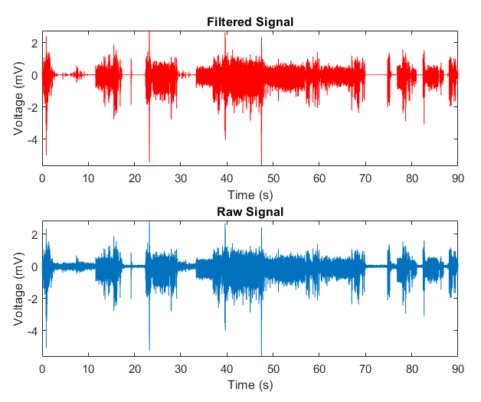
Result and Discussion
Filtered Result
The following discussion will be based on the first channel of “EMG_example_1_90s_fs_2k.csv”.
When appropriately tuned, wavelet denoising achieve the goal of filtering as well. It is noticeable that the noise at relatively low amplitude part is properly attenuated compared with the raw signal
Figure on the next page shows detailed comparison between the raw and filtered data.

Slide 13
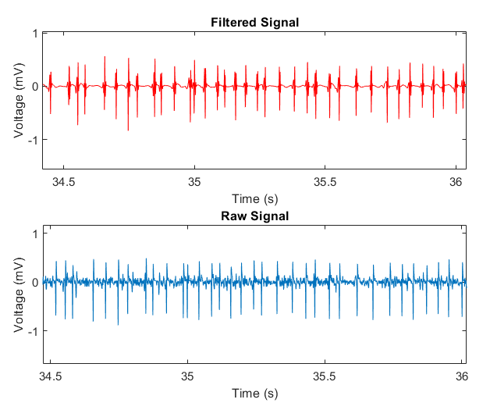
Result and Discussion
Filtered Result
When appropriately tuned, wavelet denoising achieve the goal of filtering as well. It is noticeable that the noise at relatively low amplitude part is properly attenuated compared with the raw signal
Figure on the next page shows detailed comparison between the signal filtered by wavelet denoising and a bandpass filtered with passband between 20 to 500 Hz

Slide 14
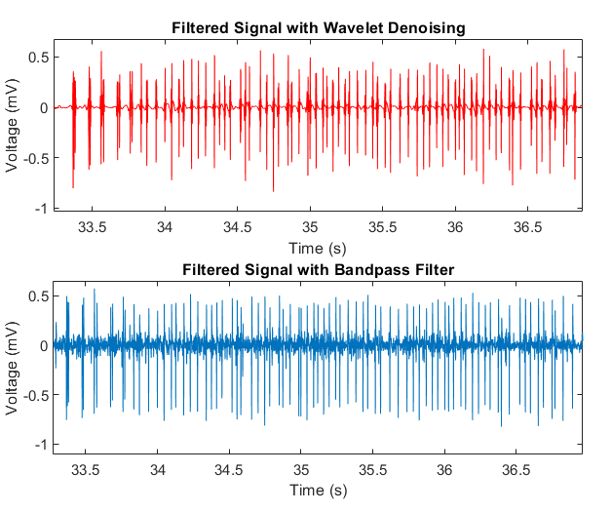
Result and Discussion
Filtered Result
When appropriately tuned, wavelet denoising achieve the goal of filtering as well.
From the comparison, wavelet denoising has some advantage over bandpass filtering in neural signal processing.
Wavelet denoising better maintains the shape of action potential and attenuate low amplitude noise within the frequency range of wanted neural signal.

Slide 15
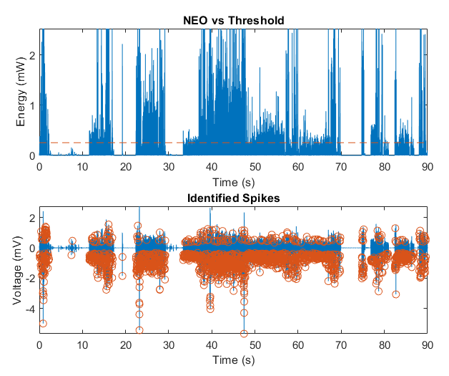
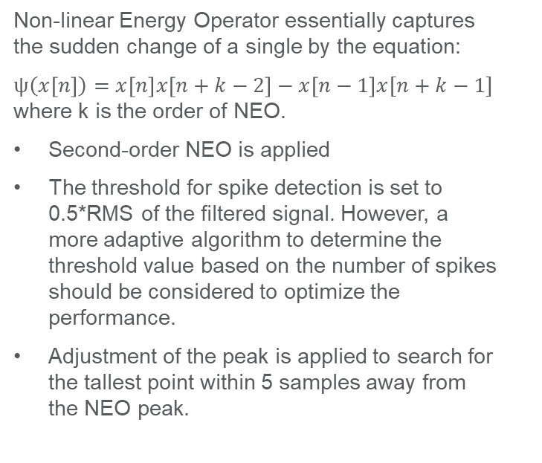
Result and Discussion
Spike detection
Non-linear Energy Operator essentially captures the sudden change of a single by the equation:
$ψ\left(x\left[n\right]\right)=x\left[n\right]x\left[n+k−2\right]−x\left[n−1\right]x[n+k−1]$ where k is the order of NEO.
Second-order NEO is applied
The threshold for spike detection is set to 0.5*RMS of the filtered signal. However, a more adaptive algorithm to determine the threshold value based on the number of spikes should be considered to optimize the performance.
Adjustment of the peak is applied to search for the tallest point within 5 samples away from the NEO peak.

Slide 16
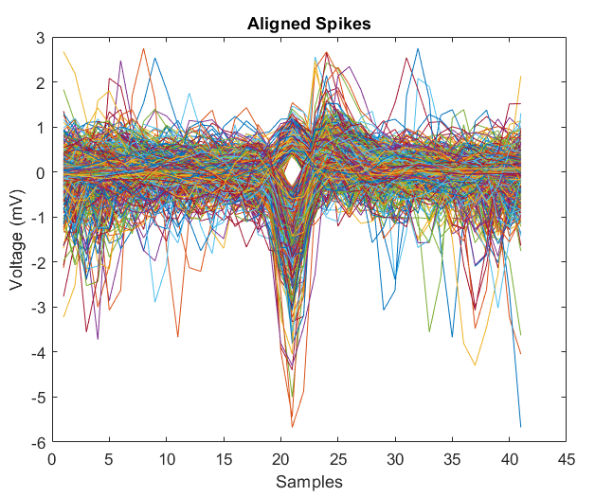
Result and Discussion
Spike Alignment
After spike detection, spike alignment can be achieved by aligning the point with the greatest amplitude to the center.
When a spike appears at the very beginning or the end of an EMG signal, zero padding is used to avoid compilation error.
An alternative would be to ignore the spikes mentioned above since their irregular shape may affect the performance of classification.

Slide 17
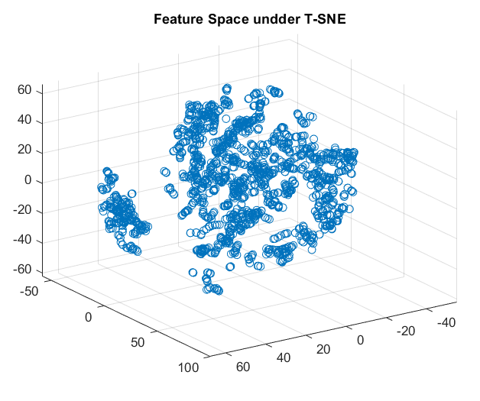
Result and Discussion
Feature extraction
T-SNE increases the separability between spike samples. For a sample of detected spikes that has low separability/variance, T-SNE may creates a better feature space than PCA.
Compared with PCA, T-SNE requires more tuning. Small number of neighboring samples results in better separability and more potential over classification. Big number of neighboring results in poor separability.

Slide 18
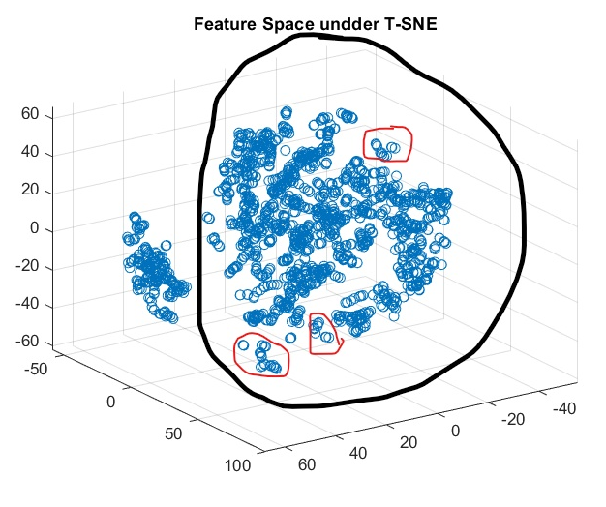
Result and Discussion
Feature extraction
Convergence is another problem. A large learning rate is more likely to result in low separability. However, a low learning rate can lead to low separability as well since it may converge at a local rather than global minima.
Choice of the associated clustering algorithm is important. For this example, when the number of clusters are big, K mean tends to create clusters that have relatively similar number of samples, which is the same for complete linkage since complete linkage calculate the farthest distance between clusters. Single linkage is more likely to pick out small clusters that are packed together.

Slide 19
Result and Discussion
Feature extraction
Convergence is another problem. A large learning rate is more likely to result in low separability. However, a low learning rate can lead to low separability as well since it may converge at a local rather than global minima.
Choice of the associated clustering algorithm is important. For this example, when the number of clusters are big, K mean tends to create clusters that have relatively similar number of samples, which is the same for complete linkage since complete linkage calculate the farthest distance between clusters. Single linkage is more likely to pick out small clusters that are packed together.

Slide 20
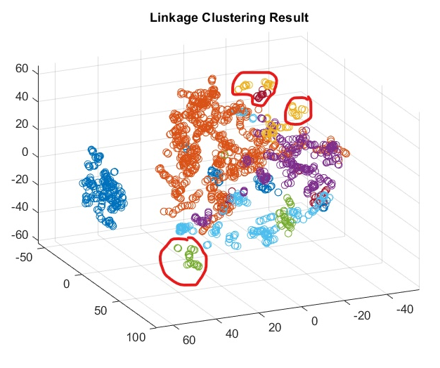
Result and Discussion
Feature extraction
After the linkage clustering, while the number of specified group is large, the number of groups contain large number spikes are relatively small. Thus, the combination of T-SNE and single linkage clustering may help to eliminate outliers.

Slide 21
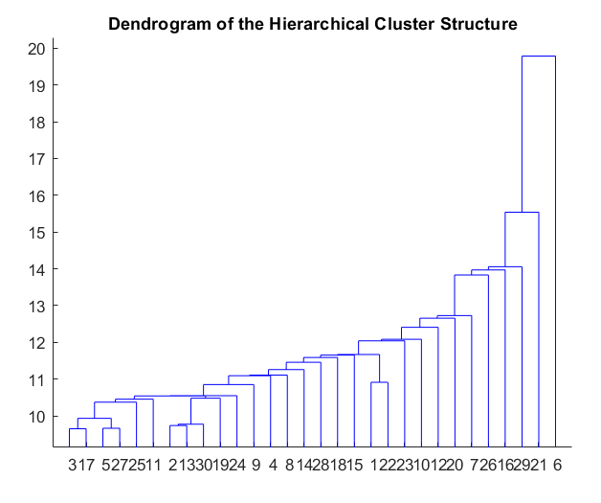
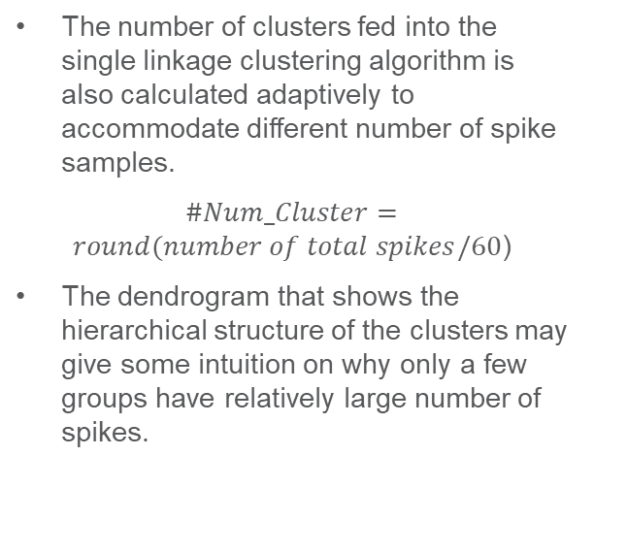
Result and Discussion
Spike Clustering
The number of clusters fed into the single linkage clustering algorithm is also calculated adaptively to accommodate different number of spike samples.
$\#Num_Cluster=round(number of total spikes/60$)
The dendrogram that shows the hierarchical structure of the clusters may give some intuition on why only a few groups have relatively large number of spikes.

Slide 22
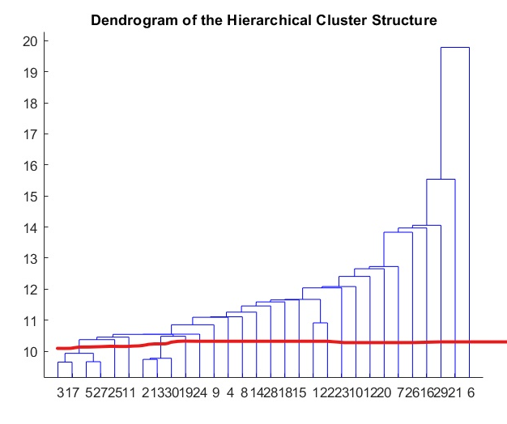
Result and Discussion
Spike Clustering
By specifying the number of clusters, the algorithm will try to find a cut (like the red line) so that the resulting number of spikes is maximized within the limit of the specified number of clusters. In this way, the more similar the samples in a big clusters are, the less likely the cluster will be disassembled into smaller clusters to satisfy the number of specified clusters.
Therefore, the resulting small clusters are likely to be a few spikes that are very similar to others.

Slide 23
Result and Discussion
Spike Clustering
However, this also introduces the risk of eliminating spikes generated by a distinct neuron but fires infrequently.
Doing so also introduces possibilities to drop out spikes within a clusters but are somehow distorted due to slightly overlapped with other spikes.

Slide 24
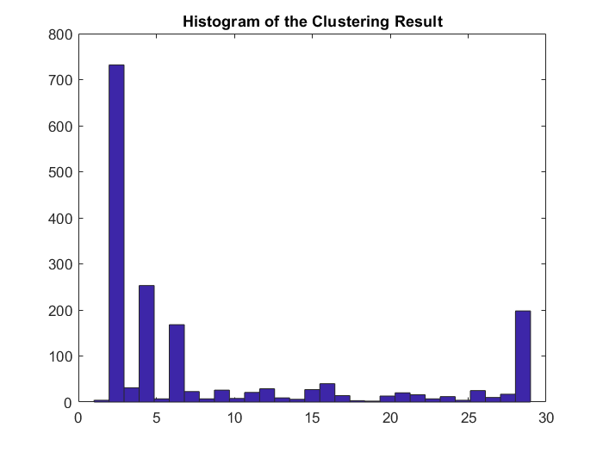
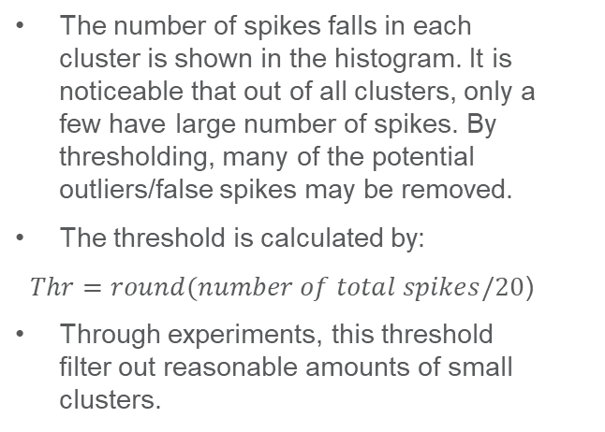
Result and Discussion
Spike Classification
The number of spikes falls in each cluster is shown in the histogram. It is noticeable that out of all clusters, only a few have large number of spikes. By thresholding, many of the potential outliers/false spikes may be removed.
The threshold is calculated by:
$Thr=round(number of total spikes/20$)
Through experiments, this threshold filter out reasonable amounts of small clusters.

Slide 25
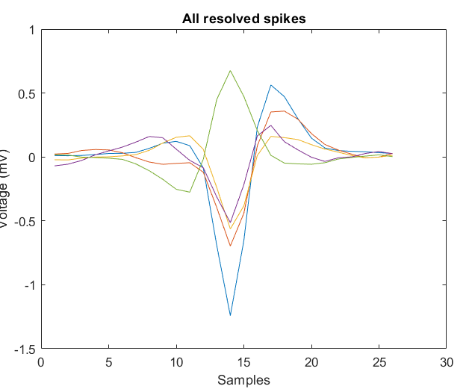
Result and Discussion
Spike Clustering
Then, the remaining samples within each cluster will be averaged to obtain the shape of action potential generated by this distinct neuron.
The figure shows the averaged action potential of 5 distinct resolved spikes.
The following 3 pages show the MUAPTs of these APs along with the filtered signal.

Slide 26
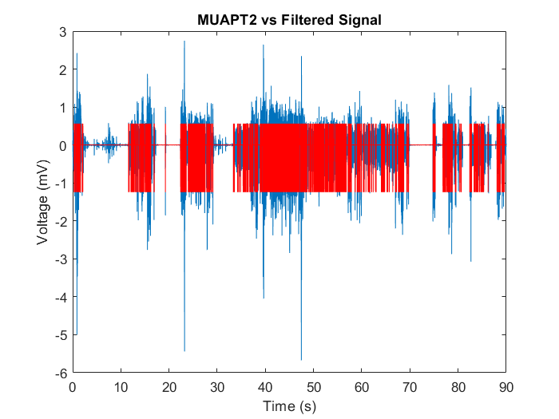
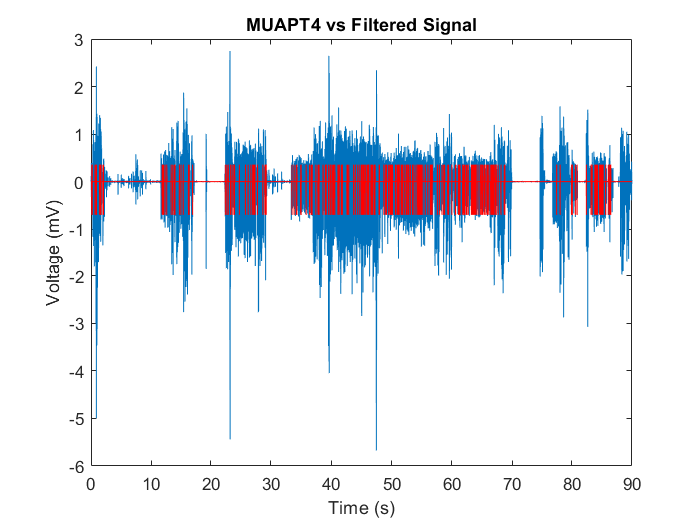
MUAPT of the 2nd Cluster
MUAPT of the 4th Cluster

Slide 27
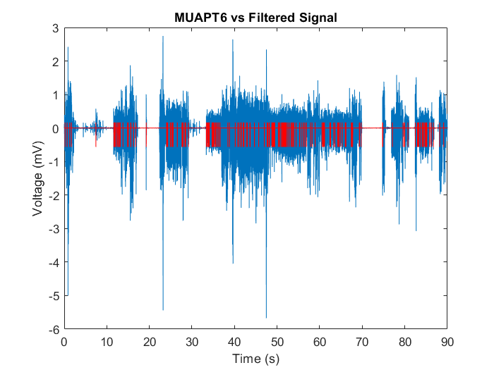
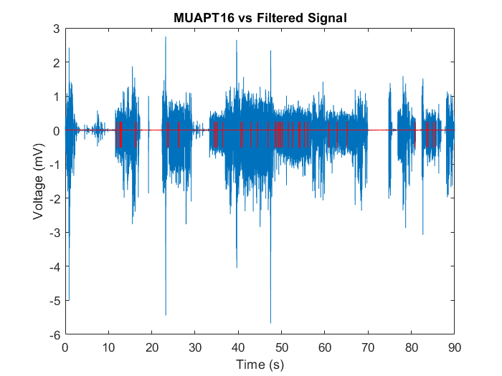
MUAPT of the 6th Cluster
MUAPT of the 16th Cluster

Slide 28
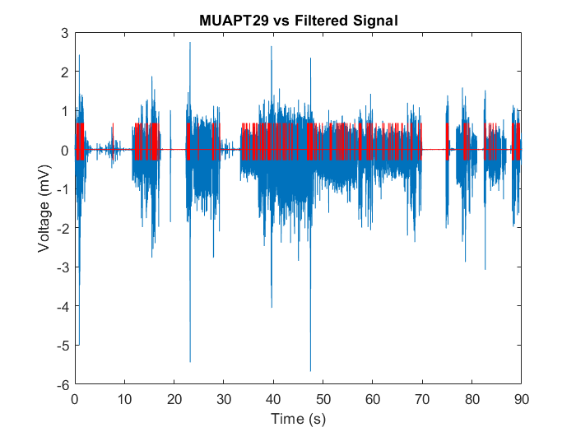
MUAPT of the 29th Cluster

Slide 29
Result and Discussion
Analysis
2 types of analysis is performed on every fed EMG signals: firing rate over time and the distribution of inter spike interval.
1 types of analysis is only performed on EMG signals that seems to be periodic: Phase locking analysis.

Slide 30
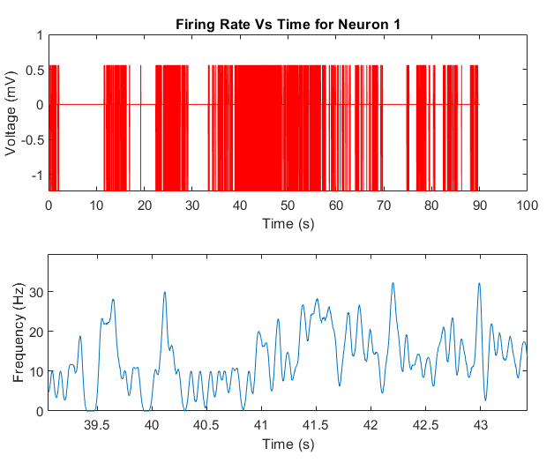
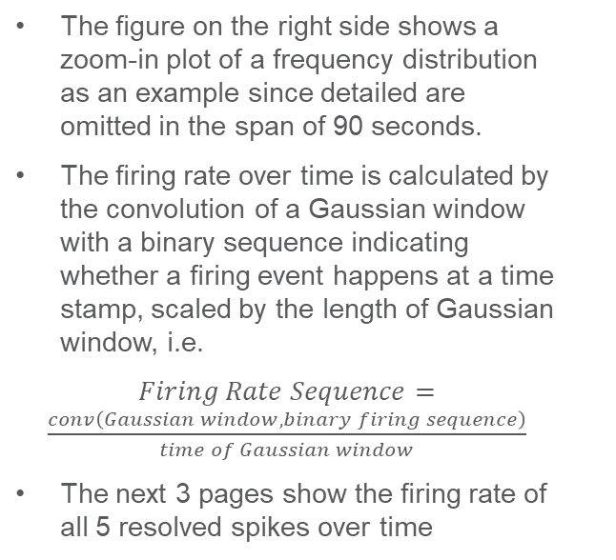
Result and Discussion
Analysis
The figure on the right side shows a zoom-in plot of a frequency distribution as an example since detailed are omitted in the span of 90 seconds.
The firing rate over time is calculated by the convolution of a Gaussian window with a binary sequence indicating whether a firing event happens at a time stamp, scaled by the length of Gaussian window, i.e.
$Firing Rate Sequence=\frac{conv\left(Gaussian window, binary firing sequence\right)}{time of Gaussian window}$
The next 3 pages show the firing rate of all 5 resolved spikes over time

Slide 31
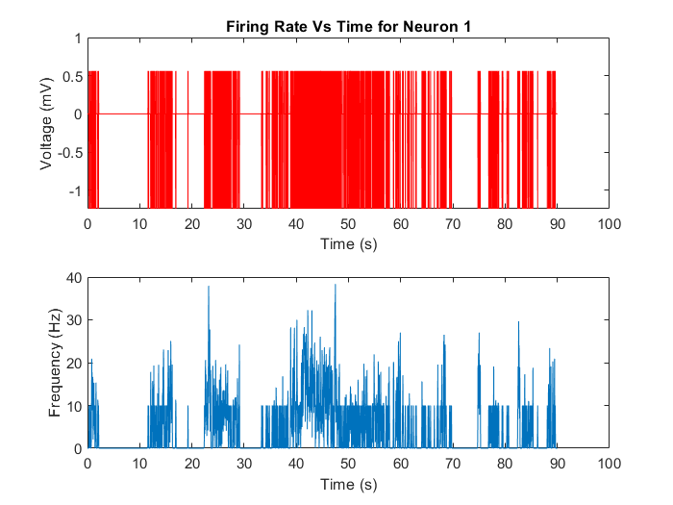
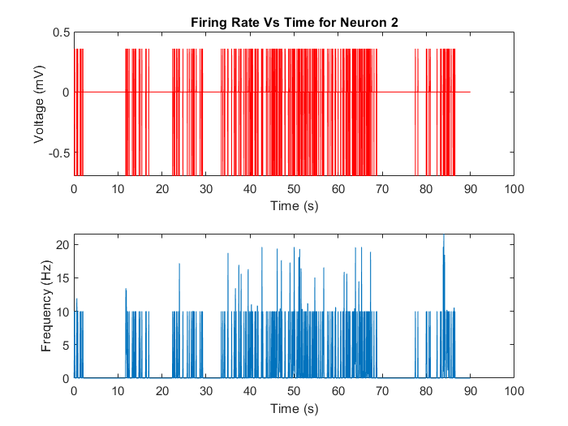
1st Neuron
2nd Neuron

Slide 32
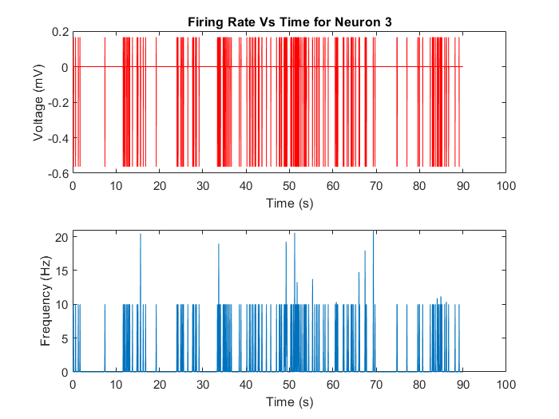
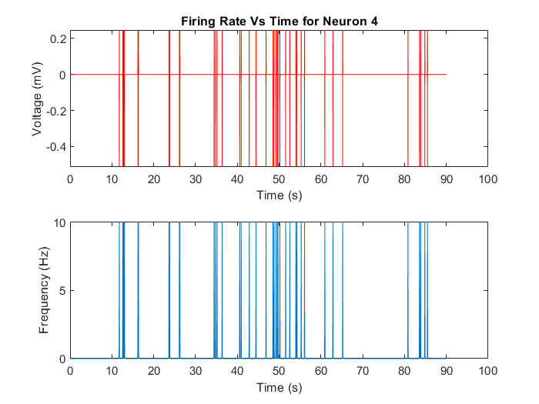
3rd Neuron
4th Neuron

Slide 33
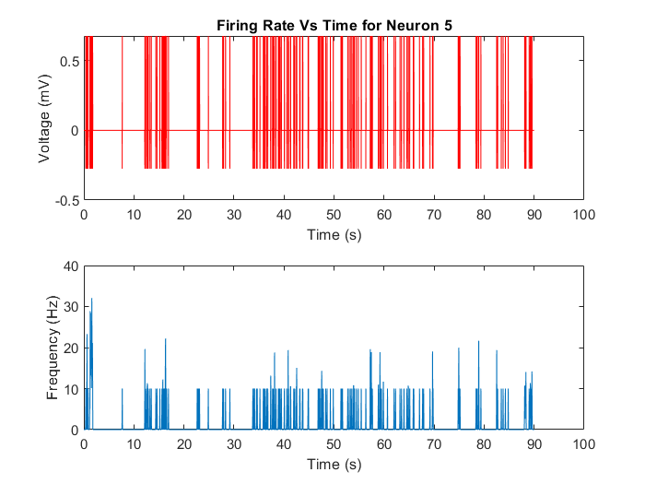
5th Neuron

Slide 34
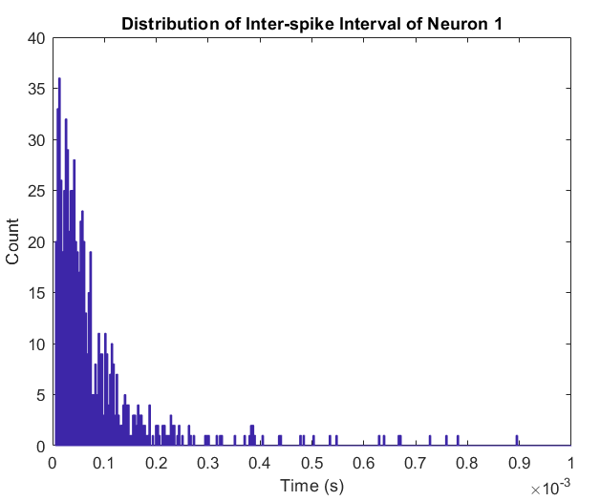
Result and Discussion
Analysis
The figure on the right side shows the histogram of the distribution of inter-spike interval of the first neuron which contains the largest amounts of spikes.
The distribution resembles a Poisson distribution, which means neuron firing can be described as a simple Poisson process.
The following 4 figures show the inter-spike interval distribution of the remaining 4 neurons. The Poisson distribution firing pattern of these 4 neuron are not as clear, potentially due to the insufficient amounts of APs or the incorrect classification of APs.

Slide 35
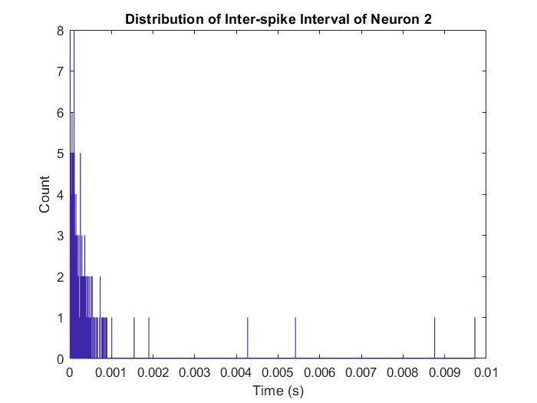
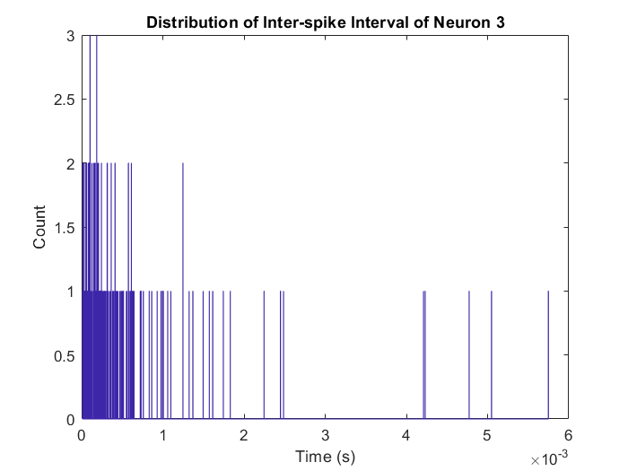
2nd Neuron
3rd Neuron

Slide 36
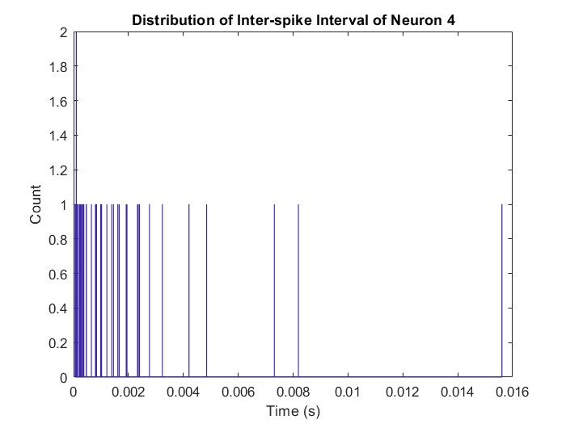
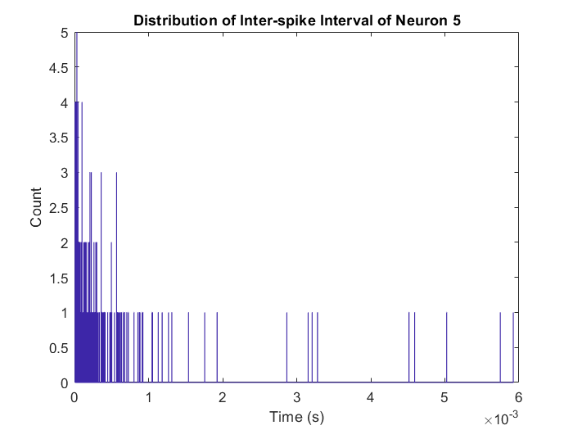
4th Neuron
5th Neuron

Slide 37
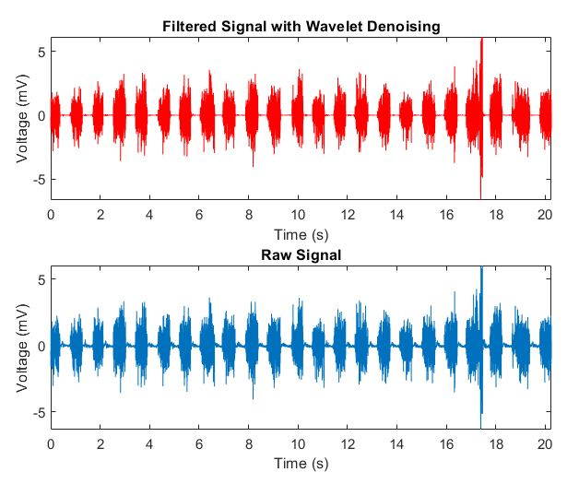
Result and Discussion
Analysis
The phase locking analysis is only performed on 1 dataset which is the first channel of “EMG_example_2_fs_2k.csv”.
The figure on the right side shows the raw and filtered signal of the first channel of “EMG_example_2_fs_2k.csv”. As the signal appears to be periodic, the signal is truncated into 22 equal-length segments. FFT are performed on those segments, which are average to whether there is a firing pattern for the spikes.

Slide 38
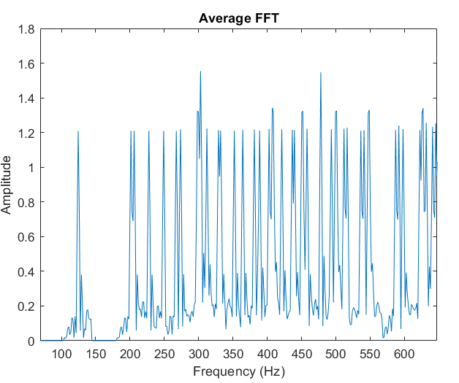
Result and Discussion
Analysis
The figure on the right shows zoom-in graph of the average FFT plot. Although the peaks of the average FFT seem to be aligned with some patterns (potentially 50Hz or 70 Hz), the pattern is not significant enough to draw a conclusion.

Slide 39
Result and Discussion
Results and figures from other datasets
As the algorithm is developed to be adaptive to different EMG recording, the following pages are some figures and results from analyzing other 2 datasets, 1 channels from each.
The steps are the same. Therefore, most of the following pages will be showing the figures.
Analytical Statement will be added when a worth-mentioning comparison can be made.
The first part will be the first channel from “EMG_example_2_fs_2k.csv”.
The second part will be the first channel from “EMG_example_20s_2000Hz-2020.csv”.

Slide 40
Result and Discussion
Filtered Result

Slide 41
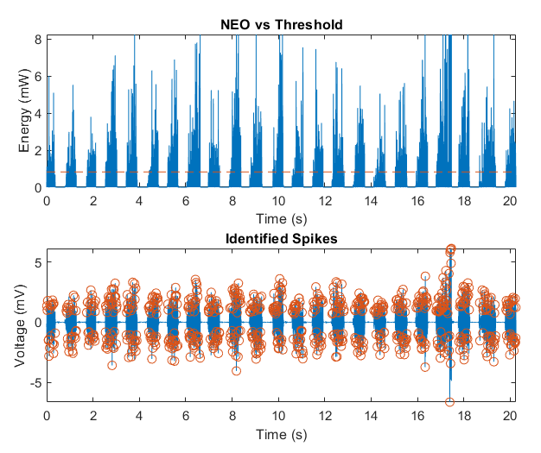
Result and Discussion
Spike Detection

Slide 42
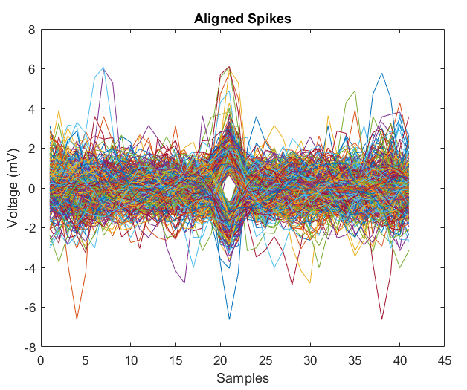
Result and Discussion
Spike Alignment

Slide 43
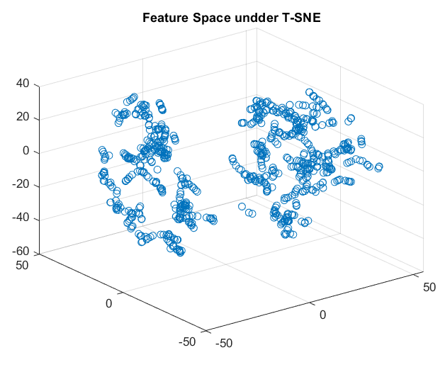
Result and Discussion
Feature extraction

Slide 44
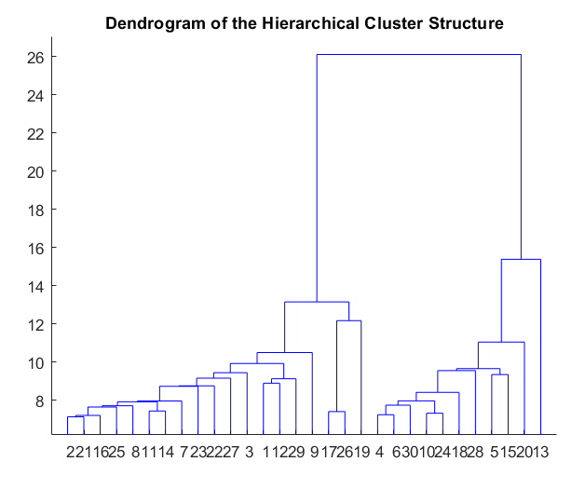
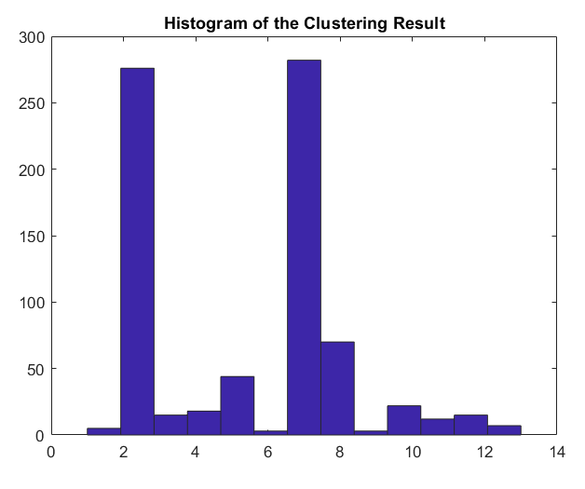
Result and Discussion
Cluster Spikes

Slide 45
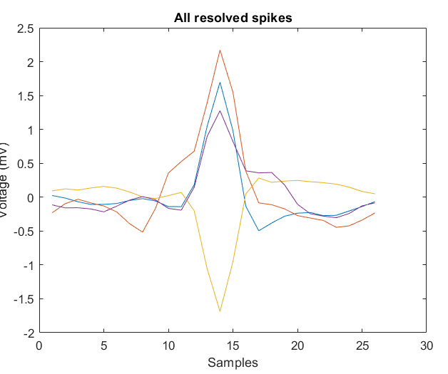
Result and Discussion
Classify Spikes

Slide 46
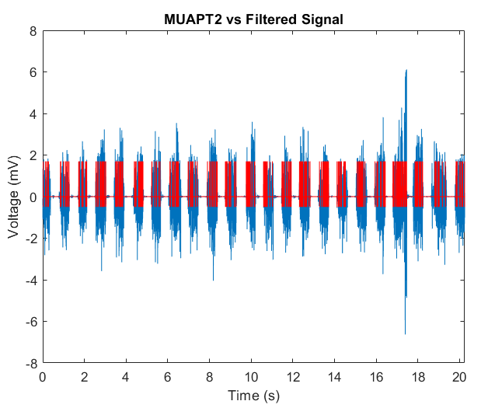
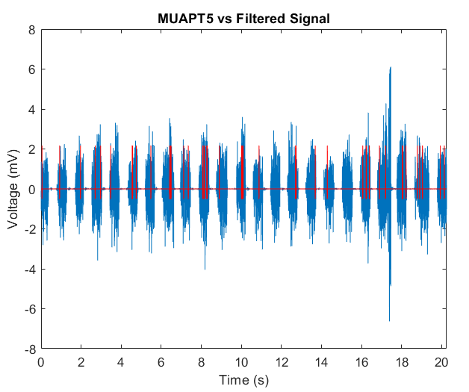
Result and Discussion
Classify Spikes

Slide 47
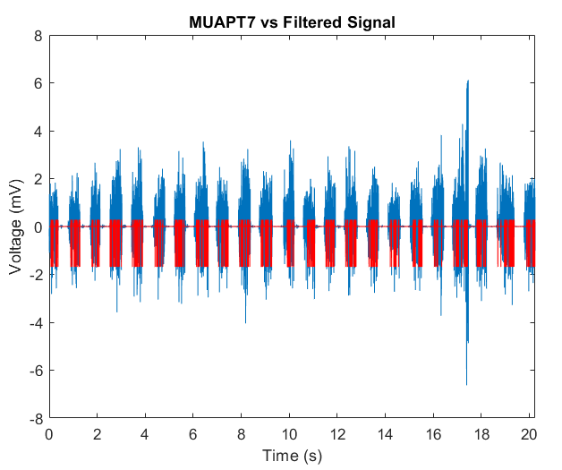
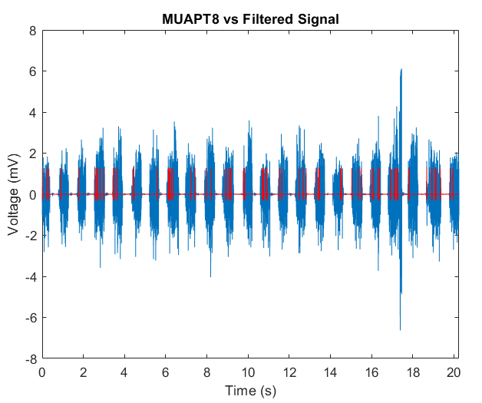
Result and Discussion
Classify Spikes

Slide 48
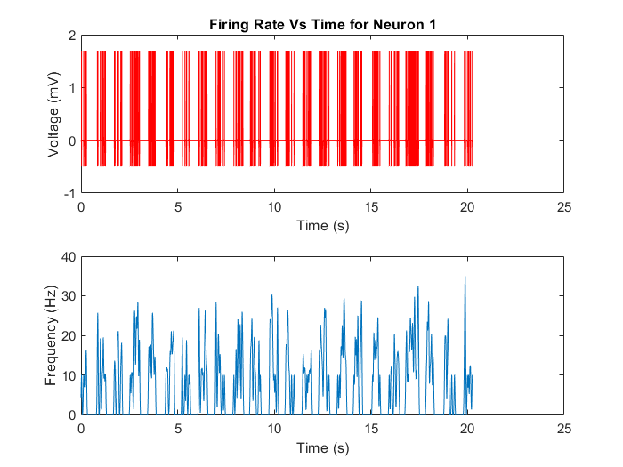
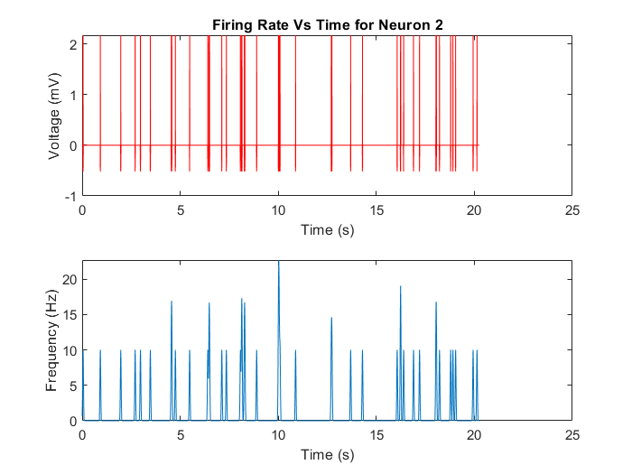
ANALYSIS

Slide 49
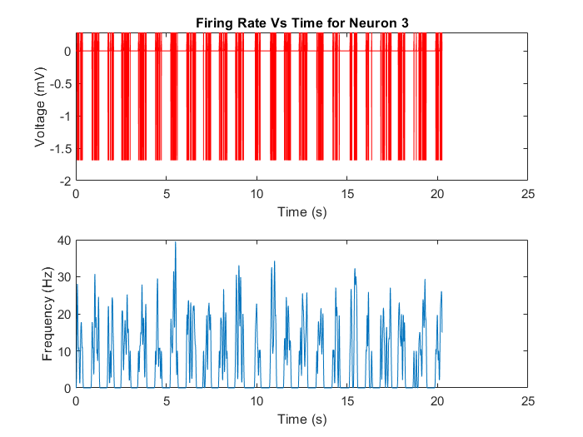
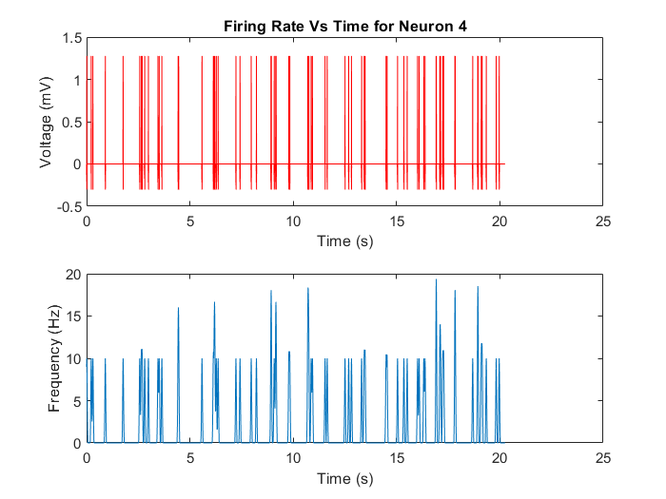
ANALYSIS

Slide 50
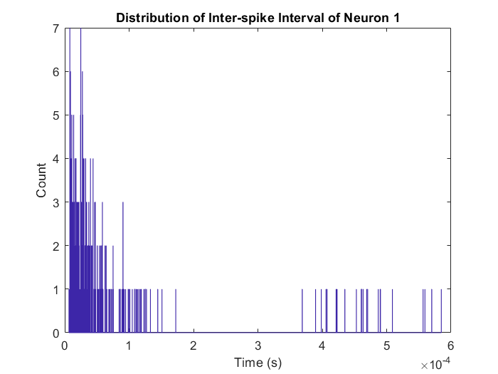

ANALYSIS

Slide 51


ANALYSIS

Slide 52
Result and Discussion
Results from the last dataset
The following figures will be from the first channel of the dataset “EMG_example_20s_2000Hz-2020.csv”.

Slide 53
Result and Discussion
Filtered Result

Slide 54

Result and Discussion
Spike Detection

Slide 55

Result and Discussion
Aligned Spike

Slide 56

Result and Discussion
Feature Extraction

Slide 57

Result and Discussion
Cluster Spikes

Slide 58


CLUSTER SPIKES

Slide 59

CLASSIFY SPIKES

Slide 60


CLASSIFY SPIKES

Slide 61


CLASSIFY SPIKES

Slide 62


CLASSIFY SPIKES

Slide 63

CLASSIFY SPIKES

Slide 64


ANALYSIS

Slide 65


ANALYSIS

Slide 66


ANALYSIS

Slide 67

ANALYSIS

Slide 68


ANALYSIS

Slide 69


ANALYSIS

Slide 70


ANALYSIS

Slide 71

ANALYSIS

Slide 72
Comparison
From the comparison of 3 dataset, a few points that are worth-mentioning are the followings:
The inter-spike interval distribution may provide insight on whether the classification is correct. A more Poisson-like distribution is more likely to be a well-classified spike.
Wavelet denoising may provide a new way for spike detection with proper combination of thresholding as the resulted high peaks are related to a sudden changes in the raw data.
The preset hyperparameter and the adaptive thresholding in the algorithm tend to work better on larger number of samples.

Slide 73
Conclusion
After the evaluation of a few EMG signals and the comparison between them, some advantage of the algorithm does exist while many problems exist.
Pros
Acceptable accuracy when dealing with signals that are less overlapped and number of spikes are over 1000.
Fully autonomous feature with some simple adaptive tuning
Ability to drop potential false spike samples
Cons
Sensitive hyperparameters in T-SNE
T-SNE cascaded with linkage of large cluster number may leads to contradicting results between different iteration
Low accuracy when dealing with small number of samples as it tends to over classify spikes in this scenario.

